Slide 1

Advanced Big Data Analysis Chapter 1.3 Things Useful to Know

Slide 2
Topics in this chapter
TF.IDF
Hash Functions
Index
Secondary Storage (Disk)
Base 'e' and Natural Logarithms
Power Laws

Slide 3
TF.IDF (Term Frequency . Inverse Document Frequency)
Term Frequency (TF):
Measures how frequently a term (word) appears in a document.
Inverse Document Frequency (IDF):
Measures the importance of a term by considering how many documents it appears in. Rarer terms get higher IDF values.
Formula: TF-IDF = TF * IDF
Notes:
Zusammenfassung in einem Satz: This measure measures the importance of words within documents.

Slide 4
Example and Application of TF.IDF
Example: Classifying documents by topic, terms with high TF-IDF scores can indicate the topic (e.g.,”football", "goal", "referee" for documents about soccer).
Application: Used in search engines and information retrieval systems to find and classify relevant documents.

Slide 5
Hash Functions
Definition: A hash function maps a key (hash-key) to a number (bucket number) for efficient data storage and retrieval.
Properties: A good hash function distributes keys as evenly as possible across buckets.

Slide 6
Example and Application of Hash Functions
Examples of Hash Functions:
Division Method (Modulo): The key is divided by the number of buckets, and the remainder is used as the bucket index.
Let's say we have 10 buckets (0 through 9) and a key value of 1234.
1234 % 10 = 4
So, the key 1234 would be placed in bucket number 4
Cryptographic Hash Functions (SHA256): Creates a unique ‘fingerprint’ of the data that is difficult to reverse. Useful for Data Integrity Checks
SHA-256(‘Hello world!’) = ‘dffd6021bb2bd5b0af676290809ec3a53191dd81c7f70a4b28688a36239a7fef’
Application: Hash functions are used in hash tables, data structures, and data mining algorithms.

Slide 7
Indexes
Definition: A data structure that allows objects to be efficiently searched for based on the value of one or more of their elements.
Advantages: Dramatically speeds up data retrieval compared to scanning the entire dataset.

Slide 8
Implementation and Application of Indexes
Implementation: Hash tables are one way to implement indexes. The field(s) being indexed form the hash-key, and records are stored in buckets based on their hash value.
Application: Widely used in databases and other applications where fast data lookup is critical.

Slide 9
Example of Hash Functions and Indexes
Example: Searching in a Telephone Book
We have a Dataset with with 10.000 Data records, each record hast Phone Number and Name
Sequential Search
all 10,000 entries would have to be checked
takes an estimated 10 seconds
Hashtable Search
hash function that uses the last three digits of the phone number to determine the bucket number / Index
hash table has 1,000 buckets, which means that each bucket contains an average of 10 entries => reduces the search time to 0,1 seconds

Slide 10
Secondary Storage (Disk)
Definition: Unlike main memory (RAM), secondary storage (e.g., hard disk) is slower but offers more storage capacity.
Time: Accessing data on disk is significantly slower than accessing data in main memory.
Impact: Disk access can greatly impact the running time of algorithms.
Optimization: Data can be organized on cylinders to minimize the number of disk accesses

Slide 11
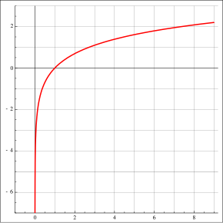
Base 'e' and Natural Logarithms
Definition: 'e' (Euler's number) is the base of the natural logarithm.
Example: e^0.5 ≈ 1.64844
Various Applications in the Data Mining Field: Probability distributions, Neural networks, Decision trees and Clustering algorithms

Slide 12
Power Laws
Definition: Describe relationships between two variables where the logarithm of one variable is linearly related to the logarithm of the other.
General Form: y = c * x^a

Slide 13
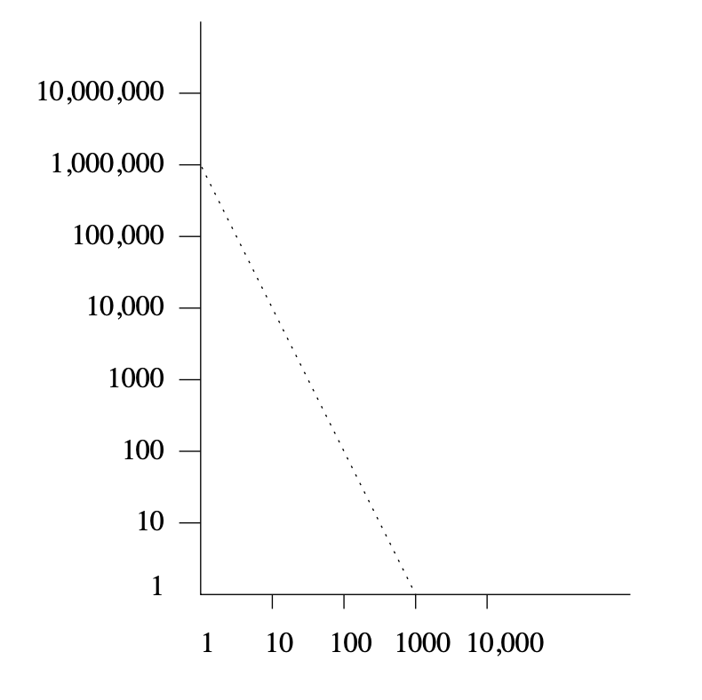
Example and Application of Power Laws
Example: Book sales (y) in relation to sales rank (x) can follow a power law.
Top-selling book (rank 1) sells around 1,000,000 copies.
10th best-selling book sells approximately 30,000 copies
100th best-selling book sells roughly 600 copies.
As the rank increases further, the sales drop significantly, showcasing the "long tail" phenomenon where a large number of books have relatively low sales.
Applications: Frequent occurrence, Recognising patterns, Prediction and modelling and Anomaly detection

Slide 14
Thanks for listening!

